Slide 1

CS-499 Capstone Code Review
Matt Jackson

Slide 2



Agenda
Structure
Documentation
Variables
Arithmetic Operations
Loops and Branches
Defensive Programming

Slide 3
Structure
Register
Main
Login
Event
List
Logout
Edit Event
Add/Edit
Logged in

Slide 4

Functionality
Permissions
Alarm Receiver
DB Helper
Event
User
EventsViewAdapter
Receiver
SendMessage

Slide 5

Documentation
This Photo by Unknown Author is licensed under CC BY-NC

Slide 6
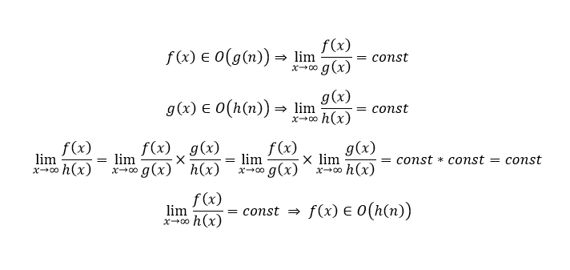
Variables
This Photo by Unknown Author is licensed under CC BY-SA

Slide 7

Loops and Branches

Slide 8

Defensive Programming

